Slide 1
Competitive Advantage and Strategic Information Systems

Slide 2
Definition
A competitive strategy: is a statement that identiﬁes a business’s strategies to compete, its goals, and the plans and policies that will be required to carry out those goals.
A competitive advantage: organization seeks to outperform its competitors in some measure such as cost, quality, or speed.
helps a company control a market and generate larger-than-average proﬁts.

Slide 3
Strategic information systems (SISs)
SISs : Information system that helps an organization gain a competitive advantage, or reduce a competitive disadvantage.
SISs provide a competitive advantage by helping an organization implement its strategic goals and increase its performance and productivity

Slide 4
Competitive Forces Model
The best-known framework for analyzing competitiveness is Michael Porter’s competitive forces model (Porter, 1985).
Companies use Porter’s model to:
develop strategies to increase their competitive edge.
demonstrates how IT can make a company more competitive.

Slide 5
Porter’s Competitive Forces Model
Identiﬁes ﬁve major forces that could either endanger or enhance a company’s position in a given industry.
The threat of entry of new competitors.
The bargaining power of suppliers.
The bargaining power of customers (buyers).
The threat of substitute products or services.
The rivalry among existing ﬁrms in the industry.

Slide 6
1. The threat of entry of new competitors.
The threat of new competitor entry is high when it is easy to enter your market and low when signiﬁcant barriers to entry exist.
An entry barrier is a product or service feature that customers have learned to expect from organizations in a certain industry.
This feature must be offered by a competing organization for it to survive in the marketplace.
The internet impact????
The Web increases the threat that new competitors will enter the market by sharply reducing traditional barriers to entry, such as the need for a sales force or a physical storefront to sell goods and services.

Slide 7
2. The bargaining power of suppliers.
Supplier power is high when buyers have few choices from whom to buy and low when buyers have many choices.
The internet impact???

Slide 8
3. The bargaining power of customers (buyers).
Buyer power is high when buyers have many choices from whom to buy and low when buyers have few choices.
The Internet greatly increases customers’ bargaining power.

Slide 9
4. The threat of substitute products or services.
If there are many substitutes for an organization’s products or services, then the threat of substitutes is high.
If there are few substitutes, then the threat is low.
Information-based industries are in the greatest danger from substitutes.

Slide 10
The rivalry among existing ﬁrms in the industry.
The threat from rivalry is high when there is intense competition among many ﬁrms in an industry.
The threat is low when the competition is among fewer ﬁrms and is not as intense.

Slide 11
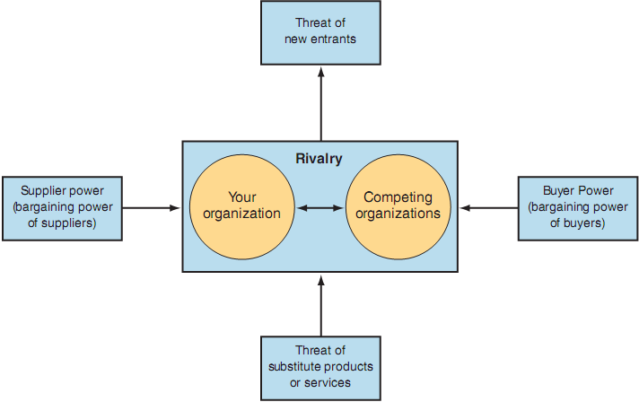
Porter’s Competitive Forces
Model

Slide 12
A proprietary system : Systems that belong exclusively to a single organization
The visibility of Internet applications on the Web makes proprietary systems more difﬁcult to keep secret.
What will you do when you see your competitor’s new system online ???

Slide 13
Competition Affect
Internet based System : changing the nature of competition
Industry Structure : “click and mortar” firm
Low variable cost of digital product

Slide 14
Porter’s Value Chain Model
Value chain model :
to identify speciﬁc activities where they can use competitive strategies for greatest impact.
shows points where an organization can use information technology to achieve competitive advantage
The activities divided into two categories:
Primary activities
Support activities

Slide 15
Primary activity
Business activities that relate to the production and distribution of the ﬁrm’s products and services.
Creating value for which customers are willing to pay.
Involve purchasing materials, processing materials into products, and delivering products to customers.

Slide 16
Primary Activities :
Inbound logistics (inputs)
Operations (manufacturing and testing)
Outbound logistics (storage and distribution)
Marketing and sales
Services

Slide 17
Support Activity
Contribute to the ﬁrm’s competitive advantage by supporting the primary activities.
Support activities consist of:
The ﬁrm’s infrastructure (accounting, ﬁnance, management)
Human resources management
Product and technology development
Procurement

Slide 18
Value System
A ﬁrm’s value chain is part of a larger stream of activities : Value system.
A value system, or an industry value chain, includes:
The suppliers
The distributors
The customers

Slide 19
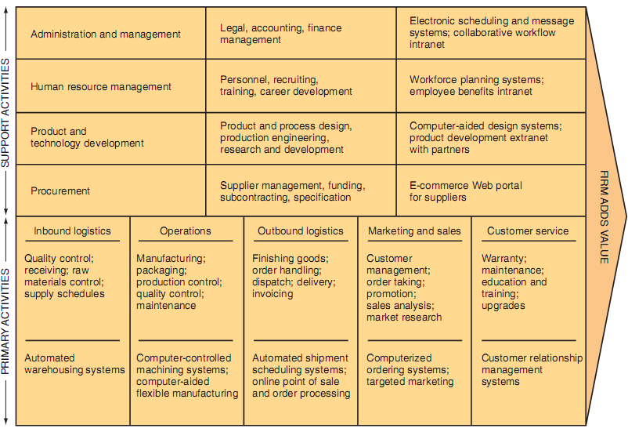
Porter’s Value Chain Model

Slide 20
Strategies for Competitive Advantage
Cost leadership strategy: Produce products and/or services at the lowest cost in the industry
Differentiation strategy: Offer different products, services, or product features.
Innovation strategy : Introduce new products and services, add new features to existing products and services, or develop new ways to produce them.
Operational effectiveness strategy : Improve the manner in which internal business processes are executed so that a ﬁrm performs similar activities better than its rivals.
Customer-orientation strategy: Concentrate on making customers happy.

Slide 21
Why Are Information Systems So Important to organization?
IT Will Reduce the Number of Middle Managers
IT Will Change the Manager’s Job
Will My Job Be Eliminated?
IT Impacts Employees at Work
IT Impacts Employees’ Health and Safety
IT Provides Opportunities for People with Disabilities
IT Provides Quality-of-Life Improvements

Slide 22






What’s in IT for each Department?
For the Accounting Major?
For the Finance Major?
For the Marketing Major?
For the Production/Operations
Management Major
For the Human Resources Management
Major?
For the MIS Major?

